Slide 1
Messaging, MOMs and Group Communication
CS 237
Distributed Systems Middleware (with slides from Cambridge Univ and Petri Maaranen)

Slide 2

Message-Oriented Middleware (MOM)
cf: www.cl.cam.ac.uk/teaching/0910/ConcDistS/
Communication using messages
  Synchronouus and asynchronous communication
Messages stored in message queues
Message servers decouple client and server
Various assumptions about message content
Client App.
Server App.
Message Servers
local message
queues
message
queues
local message
queues
Network
Network
Network
Middleware

Slide 3
Properties of MOM
cf: www.cl.cam.ac.uk/teaching/0910/ConcDistS/
Asynchronous interaction
  Client and server are only loosely coupled
  Messages are queued
  Good for application integration
Support for reliable delivery service
  Keep queues in persistent storage
Processing of messages by intermediate message server(s)
  May do filtering, transforming, logging, …
  Networks of message servers
Natural for database integration
Middleware

Slide 4
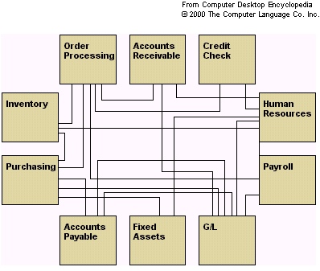
TJTST21 Spring 2006

Slide 5
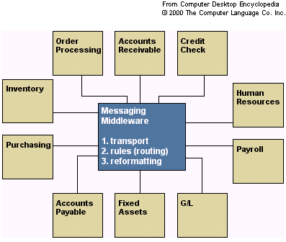
TJTST21 Spring 2006

Slide 6
Message-Oriented Middleware (4) Message Brokers
• A message broker is a software system based
on asynchronous, store-and-forward messaging.
• It manages interactions between applications
and other information resources, utilizing
abstraction techniques.
• Simple operation: an application puts (publishes)
a message to the broker, another application
gets (subscribes to) the message. The
applications do not need to be session
connected.
TJTST21 Spring 2006

Slide 7
(Message Brokers, MQ)
• MQ is fairly fault tolerant in the cases of
network or system failure.
• Most MQ software lets the message be declared
as persistent or stored to disk during a commit at
certain intervals. This allows for recovery on
such situations.
• Each MQ product implements the notion of
messaging in its own way.
• Widely used commercial examples include IBM’s
MQSeries and Microsoft’s MSMQ.
TJTST21 Spring 2006

Slide 8
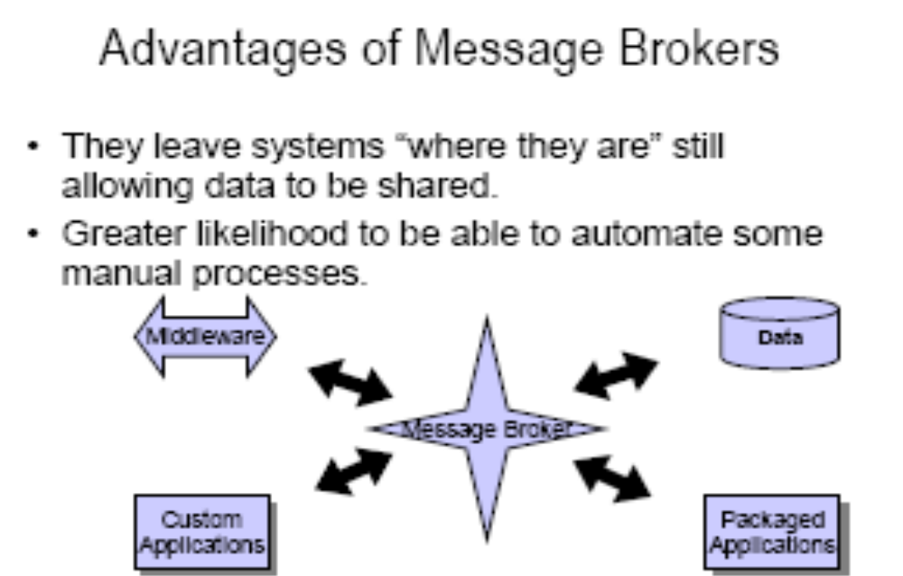
TJTST21 Spring 2006

Slide 9
Message Brokers
Any-to-any
The ability to connect diverse applications and other
information resources
– The consistency of the approach
– Common look-and-feel of all connected resources
• Many-to-many
– Once a resource is connected and publishing
information, the information is easily reusable by any
other application that requires it.
TJTST21 Spring 2006

Slide 10
Standard Features of Message Brokers
• Message transformation engines
– Allow the message broker to alter the way information is presented for each application.
• Intelligent routing capabilities
– Ability to identify a message, and an ability to route them to appropriate location.
• Rules processing capabilities
– Ability to apply rules to the transformation and routing of information.
TJTST21 Spring 2006

Slide 11
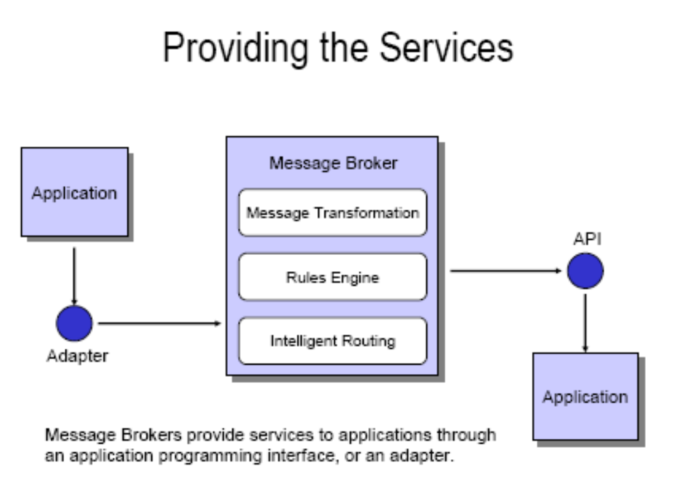
TJTST21 Spring 2006

Slide 12
Vendors
Adea Solutions[2]: Adea ESB Framework
ServiceMix[3]: ServiceMix (Apache)
[4]: Synapse (Apache Incubator)
BEA: AquaLogic Service Bus
BIE: Business integration Engine
Cape Clear Software: Cape Clear 6
Cordys: Cordys ESB
Fiorano Software Inc. Fiorano ESB™ 2006
IBM: WebSphere Platform (specifically WebSphere Message Broker or WebSphere ESB)
IONA Technologies: Artix
iWay Software: iWay Adaptive Framework for SOA
Microsoft: .NET Platform Microsoft BizTalk Server [5]
ObjectWeb: Celtix (Open Source, LGPL)
Oracle: Oracle Integration products
Petals Services Platform: EBM WebSourcing & Fossil E-Commerce (Open Source)
PolarLake: Integration Suite
LogicBlaze: ServiceMix ESB (Open Source, Apache Lic.)
Software AG: EntireX
Sonic Software: Sonic ESB
SymphonySoft: Mule (Open Source)
TIBCO Software
Virtuoso Universal Server
webMethods: webMethods Fabric
TJTST21 Spring 2006

Slide 13
Conclusions
Message oriented middleware ->
Message brokers-> ESB
Services provided by Message Brokers
Common characteristics of ESB
Products and vendors
TJTST21 Spring 2006

Slide 14
IBM MQSeries
cf: www.cl.cam.ac.uk/teaching/0910/ConcDistS/
One-to-one reliable message passing using queues
  Persistent and non-persistent messages
  Message priorities, message notification
Queue Managers
  Responsible for queues
  Transfer messages from input to output queues
  Keep routing tables
Message Channels
  Reliable connections between queue managers
Messaging API:
MQopen | Open a queue
MQclose | Close a queue
MQput | Put message into opened queue
MQget | Get message from local queue
Middleware

Slide 15
Java Message Service (JMS)
cf: www.cl.cam.ac.uk/teaching/0910/ConcDistS/
API specification to access MOM implementations
Two modes of operation *specified*:
  Point-to-point
    one-to-one communication using queues
  Publish/Subscribe
    cf. Event-Based Middleware
JMS Server implements JMS API
JMS Clients connect to JMS servers
Java objects can be serialised to JMS messages
A JMS interface has been provided for MQ
pub/sub (one-to-many) - just a specification?
Middleware

Slide 16
Disadvantages of MOM
cf: www.cl.cam.ac.uk/teaching/0910/ConcDistS/
Poor programming abstraction (but has evolved)
  Rather low-level (cf. Packets)
  Request/reply more difficult to achieve, but can be done
Message formats originally unknown to middleware
  No type checking (JMS addresses this – implementation?)
Queue abstraction only gives one-to-one communication
  Limits scalability (JMS pub/sub – implementation?)
Middleware

Slide 17
Group Communication
Communication to a collection of processes – process group
Group communication can be exploited to provide
  Simultaneous execution of the same operation in a group of workstations
  Software installation in multiple workstations
  Consistent network table management
Who needs group communication ?
  Highly available servers
  Conferencing
  Cluster management
  Distributed Logging….

Slide 18
What type of group communication ?
Peer
  All members are equal
  All members send messages to the group
  All members receive all the messages
Client-Server
  Common communication pattern
    replicated servers
  Client may or may not care which server answers
Diffusion group
  Servers sends to other servers and clients
Hierarchical
  Highly and easy scalable
Svrs
Clients

Slide 19
Message Passing System
A system consist of n objects a₀, …, a_{n-1}
Each object a_{i} is modeled as a (possible infinite) state machine with state set Q_{i}
The edges incident on a_{i} are labeled arbitrarily with integers 1 through r, where r is the degree of a_{i}
Each state of a_{i} contains 2r special components, outbuf_{i}[l], inbuf_{i}[l], for every 1 ≤ l ≤ r
A configuration is a vector C=(q_{o},…,q_{n-1}), where q_{i} is the state of a_{i}
a₁
a₀
1
2
2
3
1
1
2
1
a₃
a₂

Slide 20
Message Passing System (II)
A system is said to be asynchronous if there is no fixed upper bound on how long it takes a message to be delivered or how much time elapses between consecutive steps
Point-to-point messages
  snd_{i}(m)
  rcv_{i}(m,j)
Group communication
  Broadcast
    one-to-all relationship
  Multicast
    one-to-many relationship
    A variation of broadcast where an object can target its messages to a specified subset of objects

Slide 21
Using Traditional Transport Protocols
  TCP/IP
    Automatic flow control, reliable delivery, connection service, complexity
      linear degradation in performance
  Unreliable broadcast/multicast
    UDP, IP-multicast - assumes h/w support
    message losses high(30%) during heavy load
      Reliable IP-multicast very expensive

Slide 22
Group Communication Issues
Ordering
Delivery Guarantees
Membership
Failure

Slide 23
Ordering Service
Unordered
Single-Source FIFO (SSF)
  For all messages m₁, m₂ and all objects a_{i}, a_{j}, if a_{i} sends m₁ before it sends m₂, then m₂ is not received at a_{j} before m₁ is
Totally Ordered
  For all messages m₁, m₂ and all objects a_{i}, a_{j}, if m₁ is received at a_{i} before m₂ is, the m₂ is not received at a_{j} before m₁ is
Causally Ordered
  For all messages m₁, m₂ and all objects a_{i}, a_{j}, if m₁ happens before m₂, then m₂ is not received at a_{i} before m₁ is

Slide 24
Delivery guarantees
  Agreed Delivery
      guarantees total order of message delivery and allows a message to be delivered as soon as all of its predecessors in the total order have been delivered.
  Safe Delivery
      requires in addition, that if a message is delivered by the GC to any of the processes in a configuration, this message has been received and will be delivered to each of the processes in the configuration unless it crashes.

Slide 25
Membership
Messages addressed to the group are received by all group members
If processes are added to a group or deleted from it (due to process crash, changes in the network or the user's preference), need to report the change to all active group members, while keeping consistency among them
Every message is delivered in the context of a certain configuration, which is not always accurate. However, we may want to guarantee
  Failure atomicity
  Uniformity
  Termination

Slide 26
Failure Model
Failures types
  Message omission and delay
    Discover message omission and (usually) recovers lost messages
  Processor crashes and recoveries
  Network partitions and re-merges
Assume that faults do not corrupt messages ( or that message corruption can be detected)
Most systems do not deal with Byzantine behavior
Faults are detected using an unreliable fault detector, based on a timeout mechanism

Slide 27
Some GC Properties
  Atomic Multicast
    Message is delivered to all processes or to none at all. May also require that messages are delivered in the same order to all processes.
  Failure Atomicity
    Failures do not result in incomplete delivery of multicast messages or holes in the causal delivery order
  Uniformity
    A view change reported to a member is reported to all other members
  Liveness
    A machine that does not respond to messages sent to it is removed from the local view of the sender within a finite amount of time.

Slide 28
Virtual Synchrony
Virtual Synchrony
  Introduced in ISIS, orders group membership changes along with the regular messages
  Ensures that failures do not result in incomplete delivery of multicast messages or holes in the causal delivery order(failure atomicity)
  Ensures that, if two processes observe the same two consecutive membership changes, receive the same set of regular multicast messages between the two changes
    A view change acts as a barrier across which no multicast can pass
  Does not constrain the behavior of faulty or isolated processes

Slide 29
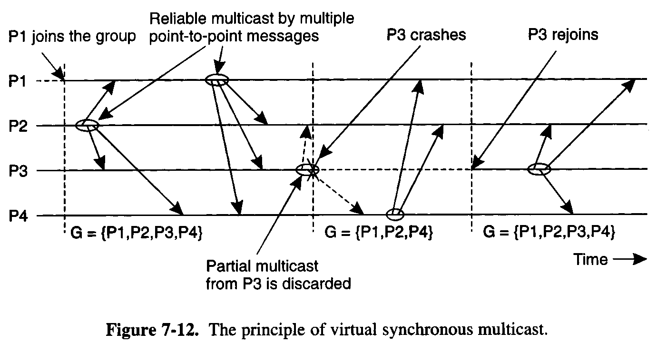

Slide 30
More Interesting GC Properties
There exists a mapping k from the set of messages appearing in all rcv_{i}(m) for all i, to the set of messages appearing in snd_{i}(m) for all i, such that each message m in a rcv() is mapped to a message with the same content appearing in an earlier snd() and:
Integrity
  k is well defined. i.e. every message received was previously sent.
No Duplicates
  k is one to one. i.e. no message is received more than once
Liveness
  k is onto. i.e. every message sent is received

Slide 31
Reliability Service
A service is reliable (in presence of f faults) if exists a partition of the object indices into faulty and non-faulty such that there are at most f faulty objects and the mapping of k must satisfy:
  Integrity
  No Duplicates
    no message is received more than once at any single object
  Liveness
    Non-faulty liveness
      When restricted to non-faulty objects, k is onto. i.e. all messages broadcast by a non-faulty object are eventually received by all non-faulty objects
    Faulty liveness
      Every message sent by a faulty object is either received by all non-faulty objects or by none of them

Slide 32
Faults and Partitions
When detecting a processor P from which we did not hear for a certain timeout, we issue a fault message
When we get a fault message, we adopt it (and issue our copy)
Problem: maybe P is only slow
When a partition occurs, we can not always completely determine who received which messages (there is no solution to this problem)

Slide 33
Extended virtual synchrony
  Introduced in Totem
  Processes can fail and recover
  Network can partition and remerge
  Does not solve all the problems of recovery in fault-tolerant distributed system, but it avoid inconsistencies

Slide 34
Extended Virtual Synchrony(cont.)
Virtual synchrony handles recovered processes as new processes
  Can cause inconsistencies with network partitions
Network partitions are real
  Gateways, bridges, wireless communication

Slide 35
Extended Virtual Synchrony Model
Network may partition into finite number of components
  Two or more may merge to form a larger component
Each membership with a unique identifier is a configuration.
    Membership ensures that all processes in a configuration agree on the membership of that configuration

Slide 36
Regular and Transitional Configurations
To achieve safe delivery with partitions and remerges, the EVS model defines:
  Regular Configuration
    New messages are broadcast and delivered
    Sufficient for FIFO and causal communication modes
  Transitional Configuration
    No new messages are broadcast, only remaining messages from prior regular configuration are delivered.
  Regular configuration may be followed and preceeded by several transitional configurations.

Slide 37
Configuration change
  Process in a regular or transitional configuration can deliver a configuration change message s.t.
      Follows delivery of every message in the terminated configuration and precedes delivery of every message in the new configuration.
  Algorithm for determining transitional configuration
    When a membership change is identified
      Regular conf members (that are still connected) start exchanging information
      If another membership change is spotted (e.g. failure cascade), this process is repeated all over again.
      Upon reaching a decision (on members and messages) – process delivers transitional configuration message to members with agreed list of messages.
      After delivery of all messages, new configuration is delivered.

Slide 38

Totem
Provides a Reliable totally ordered multicast service over LAN
Intended for complex applications in which fault-tolerance and soft real-time performance are critical
  High throughput and low predictable latency
  Rapid detection of, and recovery from, faults
  System wide total ordering of messages
  Scalable via hierarchical group communication
  Exploits hardware broadcast to achieve high-performance
Provides 2 delivery services
  Agreed
  Safe
Use timestamp to ensure total order and sequence numbers to ensure reliable delivery

Slide 39

ISIS
Tightly coupled distributed system developed over loosely coupled processors
Provides a toolkit mechanism for distributing programming, whereby a DS is built by interconnecting fairly conventional non-distributed programs, using tools drawn from the kit
Define
  how to create, join and leave a group
  group membership
  virtual synchrony
Initially point-to-point (TCP/IP)
Fail-stop failure model

Slide 40

Horus
Aims to provide a very flexible environment to configure group of protocols specifically adapted to problems at hand
Provides efficient support for virtual synchrony
Replaces point-to-point communication with group communication as the fundamental abstraction, which is provided by stacking protocol modules that have a uniform (upcall, downcall) interface
Not every sort of protocol blocks make sense
HCPI
  Stability of messages
  membership
Electra
  CORBA-Compliant interface
  method invocation transformed into multicast

Slide 41

Transis
How different components of a partition network can operate autonomously and then merge operations when they become reconnected ?
Are different protocols for fast-local and slower-cluster communication needed ?
A large-scale multicast service designed with the following goals
  Tackling network partitions and providing tools for recovery from them
  Meeting needs of large networks through hierarchical communication
  Exploiting fast-clustered communication using IP-Multicast
Communication modes
  FIFO
  Causal
  Agreed
  Safe

Slide 42
Future Challenges
Secure group communication architecture
Formal specifications of group communication systems
Support for CSCW and multimedia applications
Dynamic Virtual Private Networks
Next Generations
  Spread
  Ensemble
Wireless networks ?
  Group based Communication with incomplete spatial coverage
  dynamic membership

Slide 43
Horus
A Flexible Group Communication Subsystem

Slide 44
Horus: A Flexible Group Communication System
Flexible group communication model to application developers.
  System interface
  Properties of Protocol Stack
  Configuration of Horus
    Run in userspace
    Run in OS kernel/microkernel
Notes:
Horus can be used through several application interfaces hiding under Unix communication system and the Tcl/Tk programming language.The goal is to make Horus as transparent as possible underneath an existing system. It provides support for the virtually synchronous execution model, introduced by the Isis Toolkit.
Architecture gives flexible runtime by varying the protocol layer supporting a group. It does this by stacking protocol modules one on top of the other like lego blocks. Each module is responsible for a particular protocol. Protocol layers can be mixed and matched freely.
Horus also indtroduces run-time configuration, group communication interfaces, full tread-safety, and supporting messages that may have different addresses.

Slide 45
Architecture
Central protocol => Lego Blocks
Each Lego block implements a communication feature.
Standardized top and bottom interface (HCPI)
  Allow blocks to communicate
  A block has entry points for upcall/downcall
  Upcall=receive mesg, Downcall=send mesg.
Create new protocol by rearranging blocks.
Notes:
They used the x-kernel as a use case where the interface was not rich enough. Extensive use of general purpose operations were required causing the configuration of the system to be less flexible.
Although any combination of layers can be produced, most layers require certain semantics from the layer below them.

Slide 46
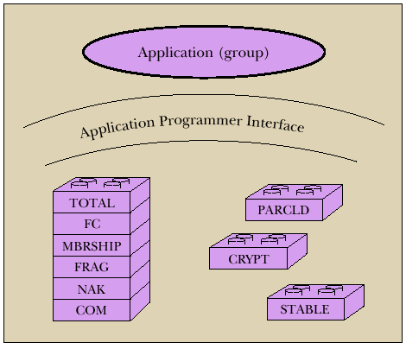

Slide 47
Message_send
Lookup the entry in topmost block and invokes the function.
Function adds header
Message_send is recursively sent down the stack
Bottommost block invokes a driver to send message.

Slide 48
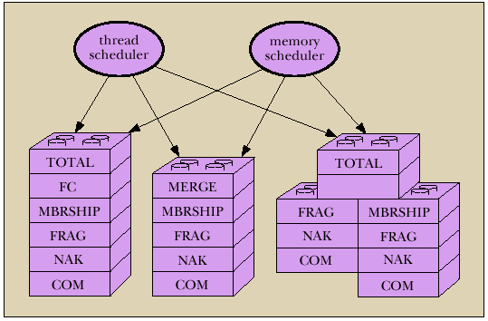
Each stack shielded from each other.
Have own threads and memory scheduler.
Notes:
Have its own prioritized threads and controlled access to memory through channels.
A thread at bottommost layer waits for messages to arrive at the network interface. When it receives a message, it truncates the header and sends the rest of the message to the layer above it. This repeats recursively. When multiple messages arrive at the same time, an order of the delivery may be lost because each message received has its own thread. Horus solves this by numbering the messages and uses event count synchronization variables to construct the order then its necessary.

Slide 49
Endpoints, Group, and Message Objects
Endpoints
  Models the communicating entity
  Have address (used for membership), send and receive messages
Group
  Maintain local state on an endpoint.
  Group address: to which message is sent
  View: List of destination endpoint addr of accessible group members
Message
  Local storage structure
  Interface includes operation pop/push headers
  Passed by reference
Notes:
Besides dealing with threads and memory, each stack needs to deal with endpoints, group , and message objects.

Slide 50
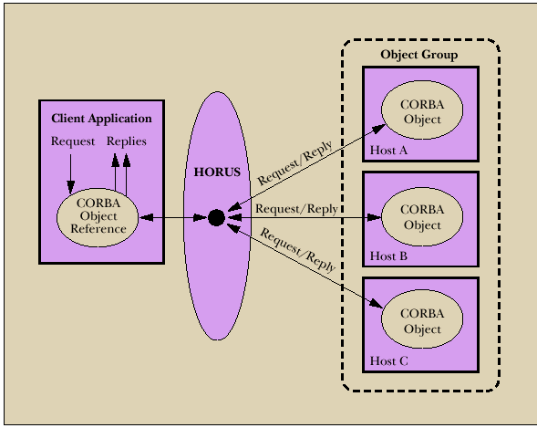
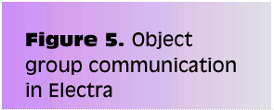
Notes:
CORBA compliant interface to Horus. Object oriented distributed applications that comply with CORBA can incoke one another’s mehtods with relative ease.

Slide 51
Transis
A Group Communication Subsystem

Slide 52
Transis : Group Communication System
Network partitions and recovery tools.
  Multiple disconnected components in the network operate autonomously.
  Merge these components upon recovery.
Hierachical communication structure.
Fast cluster communication.
Notes:
Is a multicast communication layer at the transport layer. Supports reliable process group communication for high availability, facilitates development of fault tolerant distributed applications. Groups are selected by user, messages are addresses to entire group specified by the name. The system helps abstract the user from identifying the targets and the network routes.

Slide 53
Systems that depend on primary component:
Isis System: Designate 1 component as primary and shuts down non-primary.
  Period before partition detected, non-primaries can continue to operate.
  Operations are inconsistent with primary
Trans/Total System and Amoeba:
  Allow continued operations
  Inconsistent Operations may occur in different parts of the system.
  Don’t provide recovery mechanism

Slide 54
Group Service
Work of the collection of group modules.
Manager of group messages and group views
A group module maintains
  Local View: List of currently connected and operational participants
  Hidden View: Like local view, indicated the view has failed but may have formed in another part of the system.
Notes:
Local views provided by a group service may not be accurate beacues failure detection in a system is generally unreliable. In having both local and hidden view, we get the inter-relations between views at different machines
View change reporting and message delivery at different members of a group is dealt by the group service. “Virtual Synchrony”. ..The principle guarantees that a local view is reported to any member is reported to all the members, unless they crash.

Slide 55
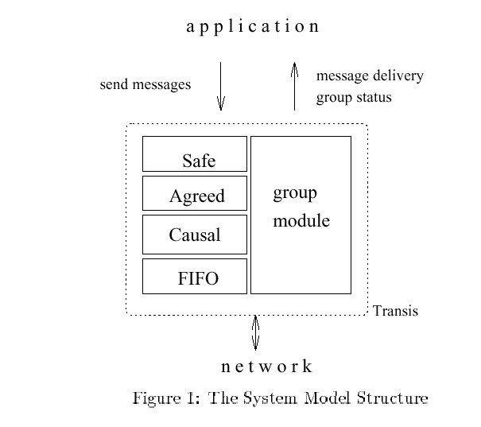
Notes:
Group multicast operations:
FIFO ordered
2. Causally ordered, guarantees response to a message is never delivered before request
3. (Agreed)Totally ordered, incurs higher delays, useful for supporting replicated data
4. Safety delivery, highest delay, delivery of the mesg after all the components have received the mesg
FIFO and causal the fastest and fastest to implement

Slide 56
Network partition wishlist
At least one component of the network should be able to continue making updates.
Each machine should know about the update messages that reached all of the other machines before they were disconnected.
Upon recovery, only the missing messages should be exchanged to bring the machines back into a consistent state.
Notes:
1.Chandra et al. have shown that it is impossible to maintain a primary component that is agreed upon and known in all circumstances. Without a primary component, a system may halt.
2.Knowing about the delivery of every message by all the components require instantaneous knowledge. It is impossible with asynchronous messaging.
3.

Slide 57
Transis supports partition
Not all applications progress is dependent on a primary component.
In Transis, local views can be merged efficiently.
  Representative replays messages upon merging.
Support recovering a primary component.
  Non-primary can remain operational and wait to merge with primary
  Non-primary can generate a new primary if it is lost.
    Members can totally-order past view changes events. Recover possible loss.
    Transis report Hidden-views.

Slide 58
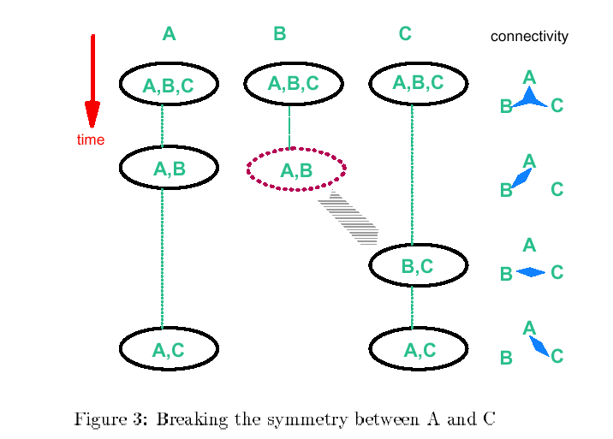

Slide 59
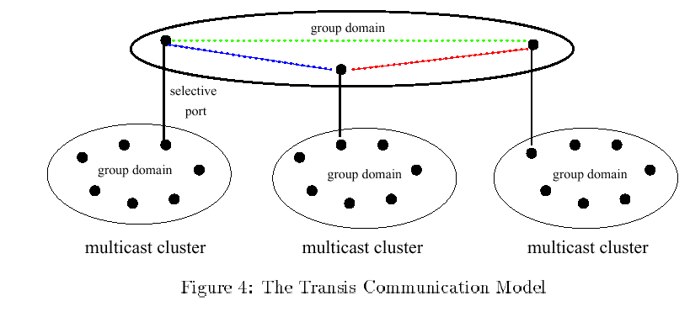
Hierarchical Broadcast
Notes:
Each multicast

Slide 60

Reliable Multicast Engine
In system that do not lose messages often
  Use negative-ack
    Messages not retransmitted
    Positive ack are piggybacked into regular mesg
Detection of lost messages detected ASAP
Under high network traffic, network and underlying protocol is driven to high loss rate.

Slide 61
Group Communication as an Infrastructure for Distributed System Management
Table Management
  User accounts, network tables
Software Installation and Version Control
  Speed up installation, minimize latency and network load during installation
Simultaneous Execution
  Invoke same commands on several machines

Slide 62
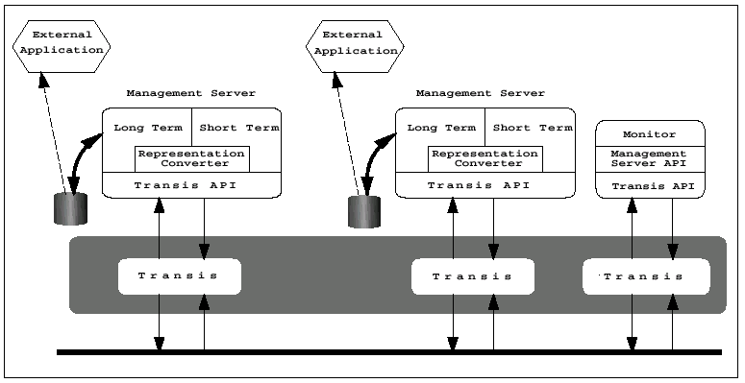
Notes:
Architecture
Transis is group communication layer: provide reliable multicast and membership services. When a membership change (network partition, merge, or server crash) it is reported by group communication layer.
Management services:
Long term: consistent semantics over partitions and over time
use for replication of network tables
Short term: Reliable as long as network is not partitioned and management server does not crash
Ex. Simultaneous execution and sw installation
A daemon, runs on each node.
Maintains a vector of contexts, 1 entry for each monitor it is currently interacting w/
also current directory of the server set by the monitor.
Monitor
Provides user interface to mgmt server.
A process, can run on any node that runs transis.
Several monitors can run simultaneously in the network

Slide 63
Management Server API
Status: Return status of server and its host machines
Chdir: Change the server’s working directory
Simex: Execute a command simultaneously
Siminist: Install a software package
Update-map: Update map while preserving consistency between replicas
Query-map: Retrieve information from the map
Exit: Terminate the management server process.

Slide 64
Simultaneous Execution
Identical management command on many machines.
  Activate a daemon, run a script
Management Server maintains
  Set M: most recent membership of the group reported by transis
  Set NR: set of currently connected servers not yet reported the outcome of a command execution to the monitor

Slide 65
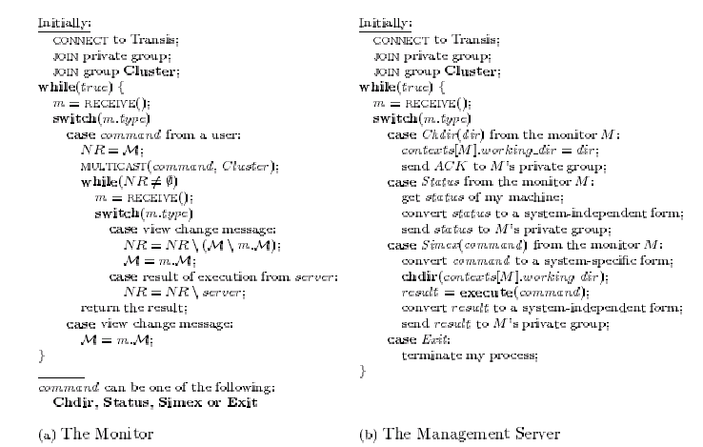

Slide 66
Software Installation
Transis disseminate files to group members.
  Monitor multicasts a msg advertising
    package P
    set of installation requirements Rp
    installation multicast group Gp
    target list Tp.
  Management server joins Gp if belongs to Rp and Tp.
  Status of all Management server reported to Monitor
Use technique in “Simultaneous Execution” to execute installation commands.
Notes:
Traditionally operations were performed using TCP/IP, waste bandwidth

Slide 67
Table Management
Consistent management of replicated network tables.
Servers sharing replicas of tables form Service Group
1 Primary Server
  Enforces total order of update mesg
  If network partition, one component (containing Primary) can perform updates

Slide 68
Questions...
Could provide tolerance for malicious intrusion
  Many mechanisms for enforcing security policy in distributed systems rely on trusted nodes
  While no single node need to be fully trusted, the function performed by the group can be
Problems
  Network partitions and re-merges
  Messages omissions and delays
  Communication primitives available in distributed systems are too weak (i.e. there is no guarantee regarding ordering or reliability)
How can we achieve group communication ?
  Extending point-to-point networks

Slide 69
From Group Communication to Transactions...
Adequate group communication can support a specific class of transactions in asynchronous distributed systems
Transaction is a sequence of operations on objects (or on data) that satisfies
  Atomicity
  Permanence
  Ordering
Group for fault-tolerance
  Share common state
  Update of the common state requires
    Delivery permanence (majority agreement)
    All-or-none delivery (multicast to multiple groups)
    Ordered delivery (serializability of multiples groups)
Transactions-based on group communication primitives represents an important step toward extending the power and generality of GComm

